Slide 1
CP3402 Content Management System
Group 2B
28/07/2024
Final Report –BaizonnLearningCenter

Slide 2
CONTENTS
Our Team
01
Development Platform
02
Our Workflow
03
Deploy Sites
04
Web show
05

Slide 3
Team Members
/01
Yuanyuan Chen
Mengcen Kui
Mike Zhi Fai (Liang Zhihui) Leong
Kaicheng Liang
Qingbo Tan
Mei Zhong

Slide 4





Development Platform
BaizonnLearningCenter
Text here
Text here
Text here
Text here
Text here
Supporting text here.
Supporting text here.
Supporting text here.
Supportng text here.
text here.
Slack
Trello
Github
Wordpress
Siteground

Slide 5
Our Workflow
Project Management
Communication and Collaboration
Local Development Environment
Version Control and Collaboration
Deploy to Staging Environment
Live Site
Project Scope
Project Plan
Use Trello
Use Slack
XAMPP, Wordpress, VSCode
GitHub for iteration
Siteground
Testing and Run

Slide 6
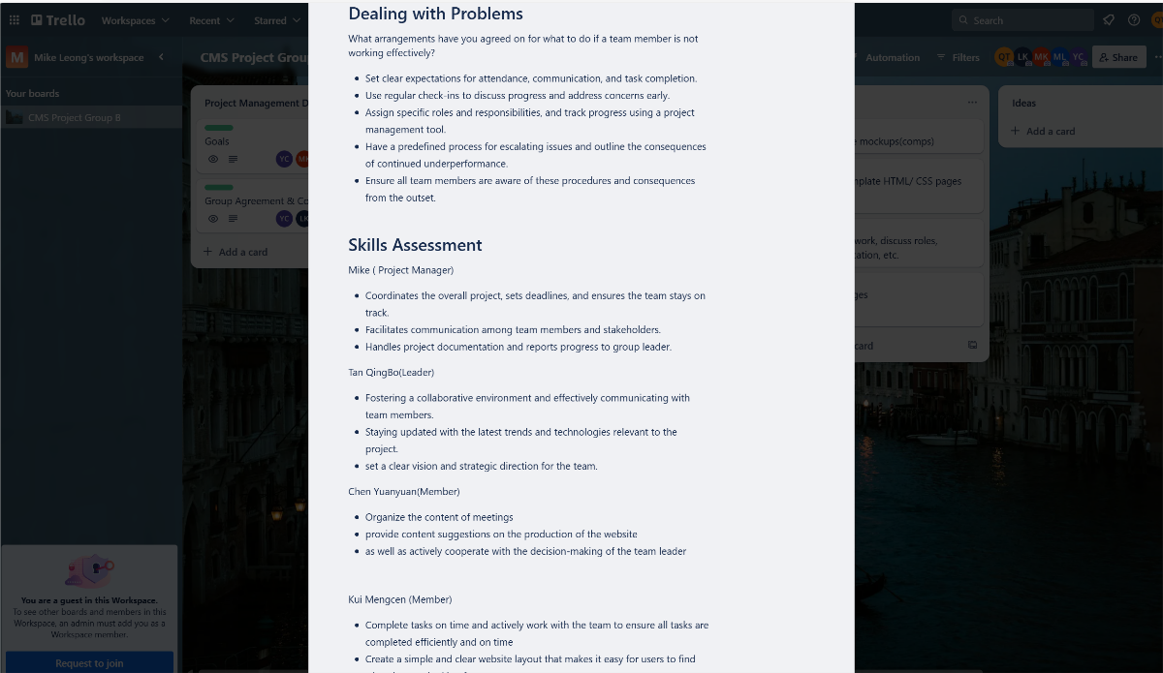
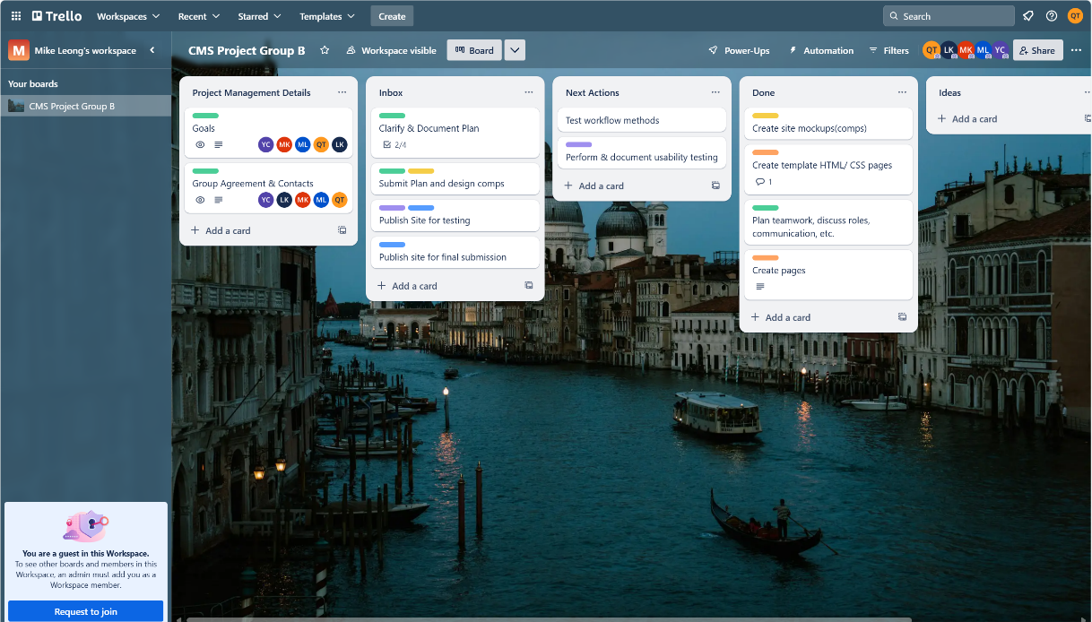
Project Management
Trello’s use of boards, lists, and cards allows for a clear visual representation of tasks and stages. This helps team members understand the project flow and scope at a glance.
Easily move tasks between different stages, making it simple to update the project status and manage the workflow.

Slide 7
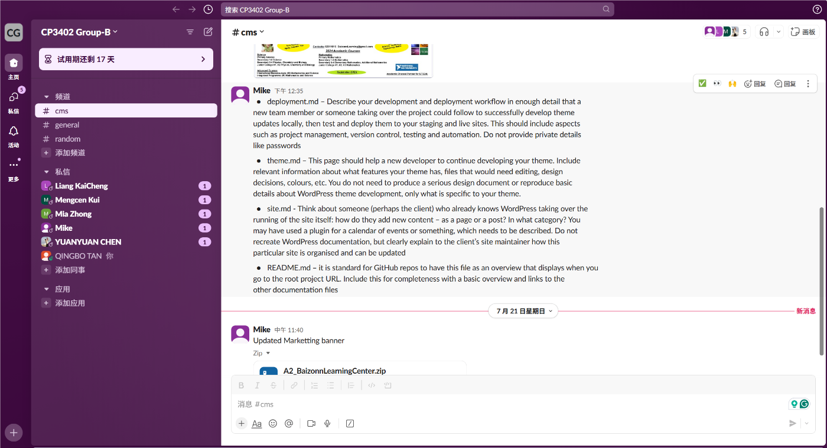
Communication and Collaboration
Easily share files, documents, and images directly within conversations, making it simple to collaborate on shared resources.
All messages and files are archived and searchable, making it easy to find past discussions and information.

Slide 8
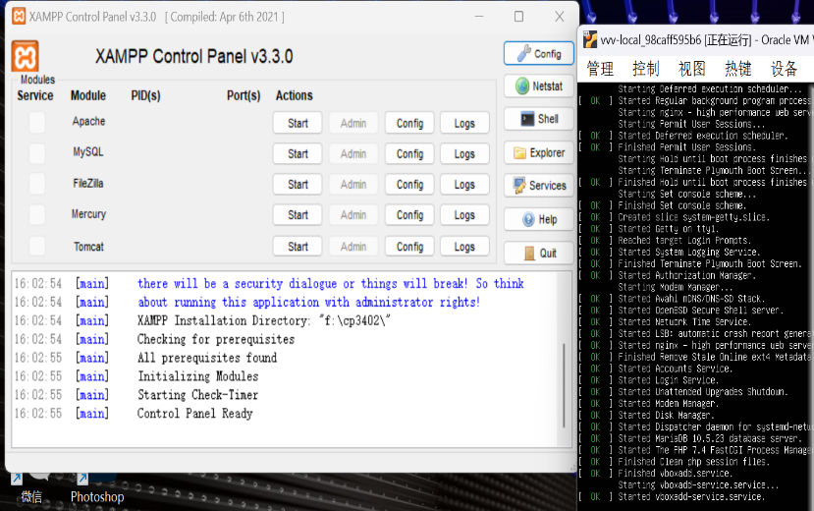
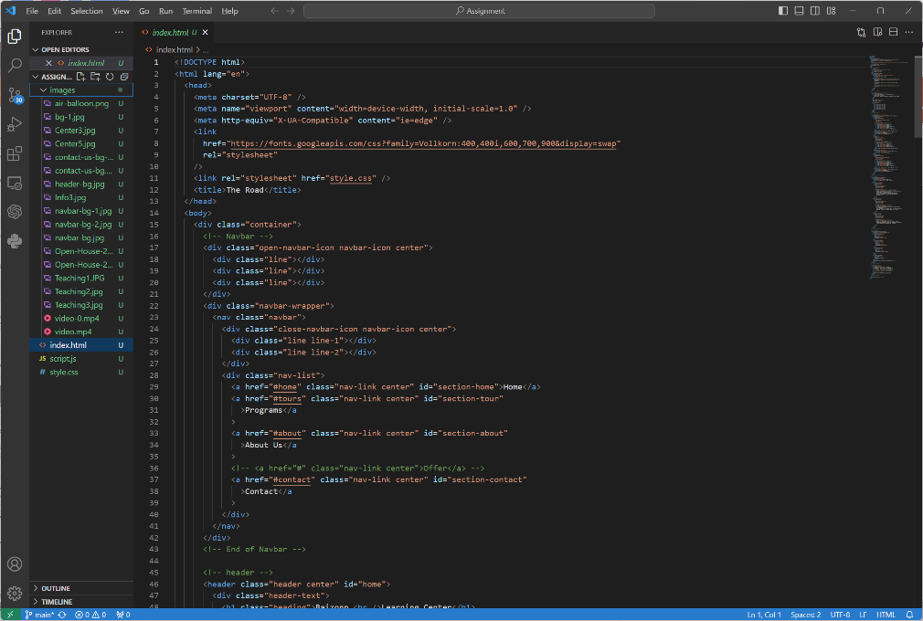
Local Development Environment
The main purpose of XAMPP suite is to enable users to set up a complete web development and testing environment on their local computer without being connected to the Internet.
Access a wide range of extensions specifically designed to enhance HTML development, such as live server previews, auto-completion, and tag management.

Slide 9
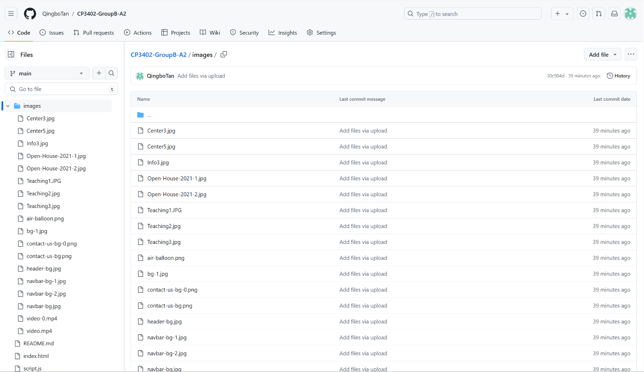
Version Control and Collaboration
View a detailed history of changes, including who made each change and why, facilitating accountability and transparency.
Visualize and manage workflows using GitHub Projects, which provide Kanban-style boards to organize tasks and track progress.

Slide 10
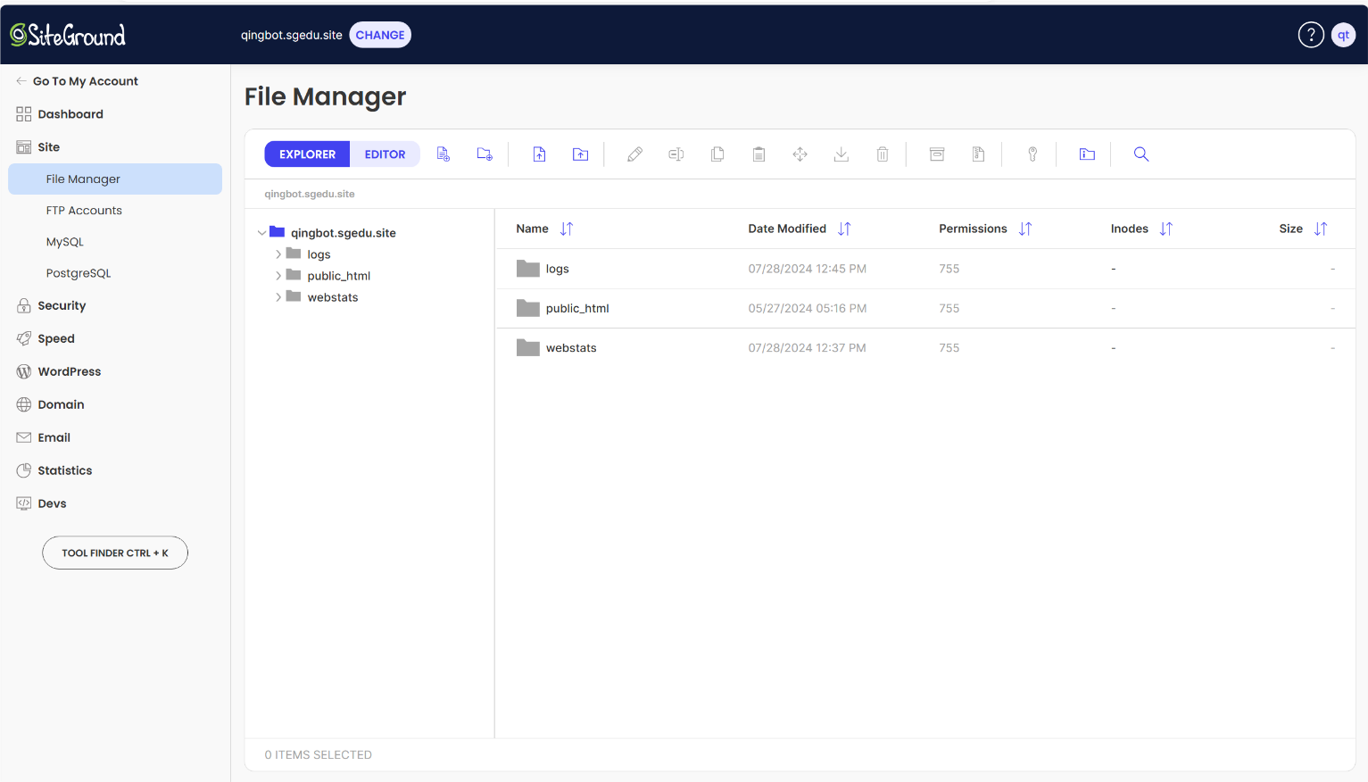
Deploy to Staging Environment
SiteGround is popular worldwide with 2.8 million users, chosen for its ease of use, high-performance servers, and excellent support, making it suitable for various websites.

Slide 11
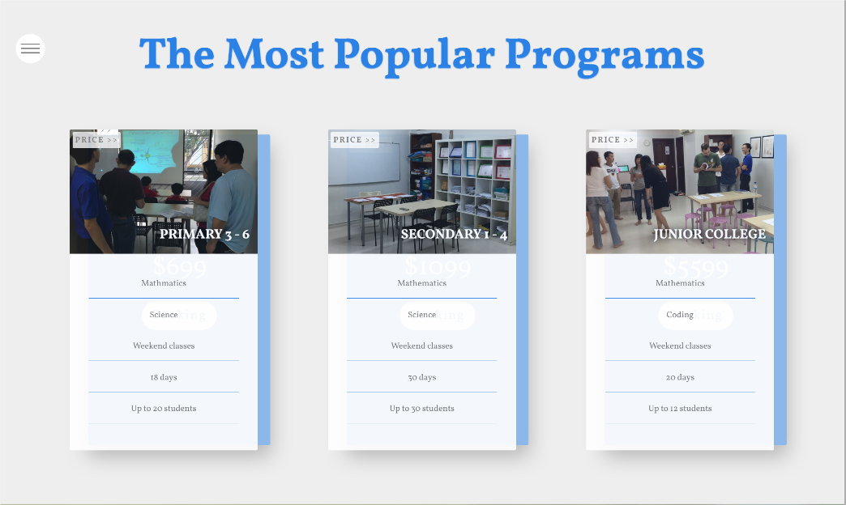



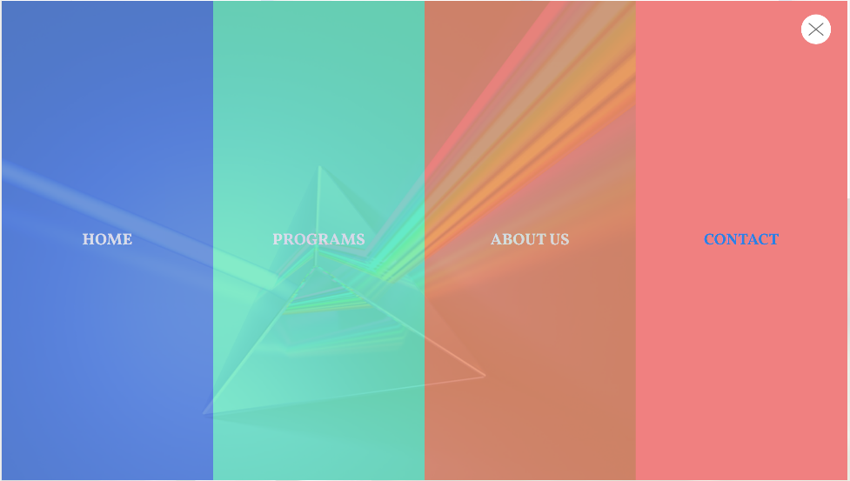
Live Site

Slide 12
Thanks
CP3402 Group2B
28/07/2024

